Slide 1
Release 5.0 – Notifications & Tally Plug-ins

Slide 2


Session Overview
About “Notifications”
What is being covered in 5.0
Product Walk through
About Tally Plug-ins
Product Walk through Tally Plug-ins
Product fixes addressed in 5.0
Q&A

Slide 3

Notifications
Introduction
Notifications is a feature which is getting included part of TP Release 5.0. The Notifications feature allows tally notifies the user on an activity about its status.
Example
Users can be notified about any license or application related Changes,
User can alert TSS Expiry and suggest user to renew, etc.
Notifications
Actionable notification that prompts user to perform an action
Non-Actionable is just an info notifications not need perform any action

Slide 4



Notifications in release 5.0
Licensing & TSS
Release Upgrade
Notifications
Connected GST

Slide 5
Product Walk through- Notification

Slide 6

Tally Plug-ins- TallyCapital
TallyCapital: We offer lending solutions that leverage existing services to empower businesses in expanding, diversifying, or optimizing their operations using Tally.​

Slide 7






Functionalities
Digital Loan Application directly from the Tally Product
Check Credit Score to Understand Current Credit History
Functionalities
EMI Calculator Helps You Determine the Repayment Tenure Wisely
Check Loan Eligibility without Impacting Credit Score
Loan Disbursement Details of Payment History, and Repayment Schedule

Slide 8


Lending Partners
Offers unsecured loans with flexible terms and a hassle-free process, exclusively for Tally customers
Kotak Mahindra Limited
FlexiLoans Technologies Pvt. Ltd.

Slide 9
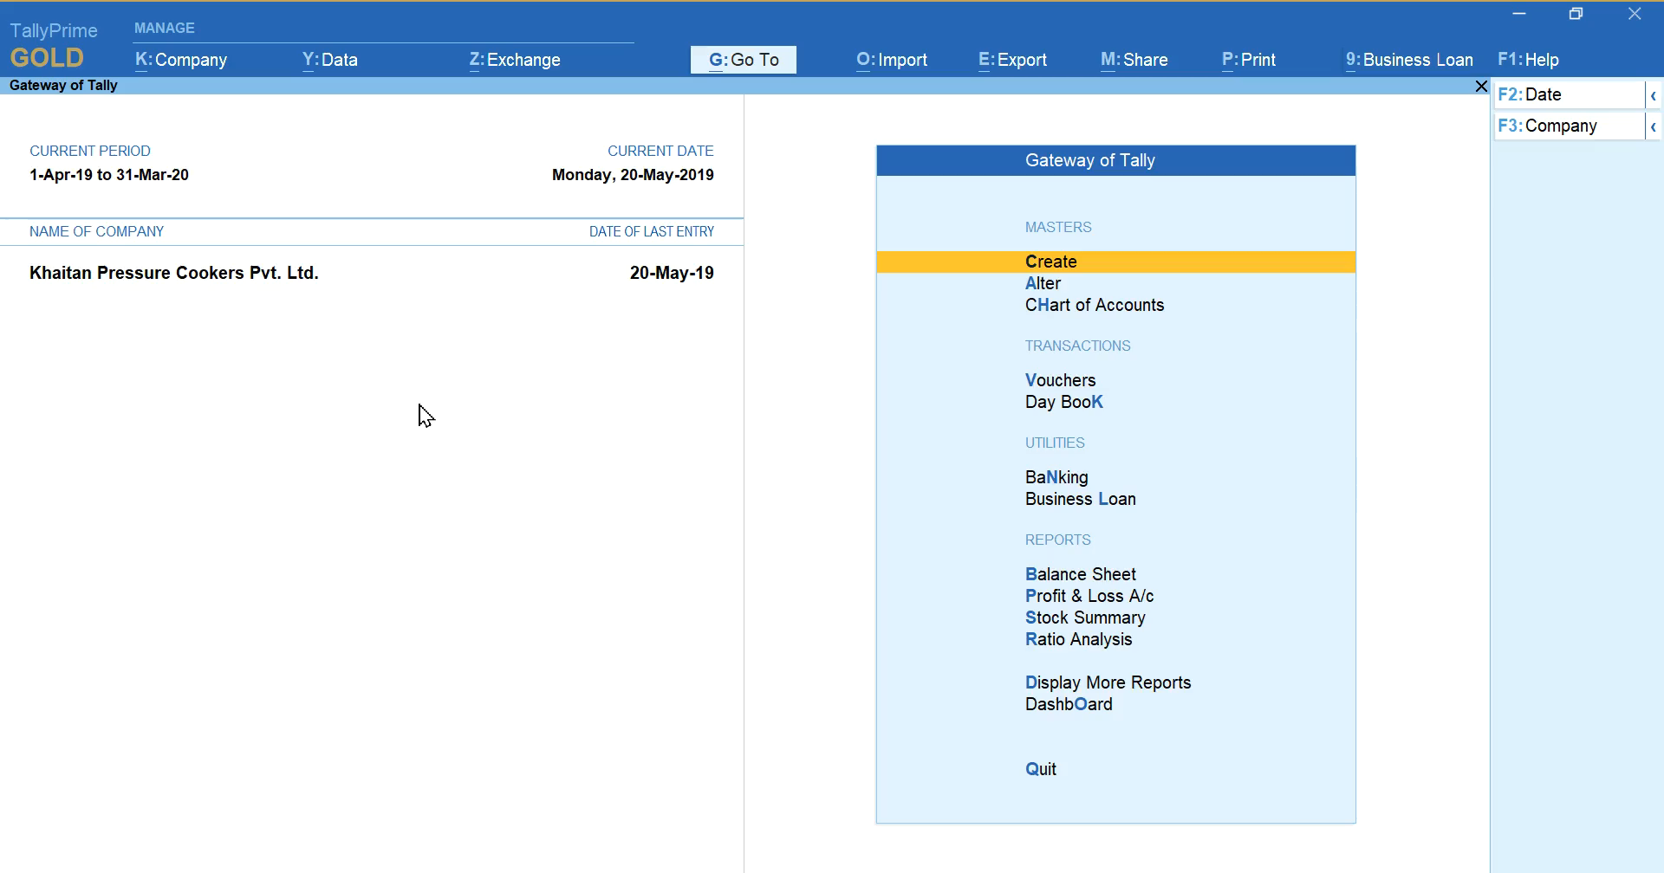

Product Walkthrough-EMI Calculator

Slide 10
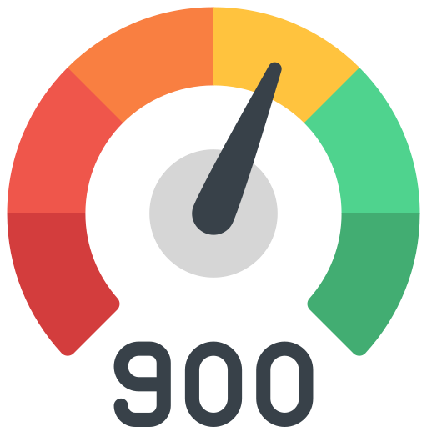
Product Walkthrough-Credit Score

Slide 11


Product Walkthrough-Check Eligibility

Slide 12


Product Walkthrough-Loan Application

Slide 13

Product Walkthrough-Disbursement Details

Slide 14
Product Fixes- Technical
Product Fixes 5.0 : ..\..\5.0 fixes\Release 5.0 Fixes.xlsx

Slide 15
Q&A

